Slide 1
Demystifying the Reactive Extensions

Slide 2
Not how to call it
But what is it doing?
Write some code

Slide 3
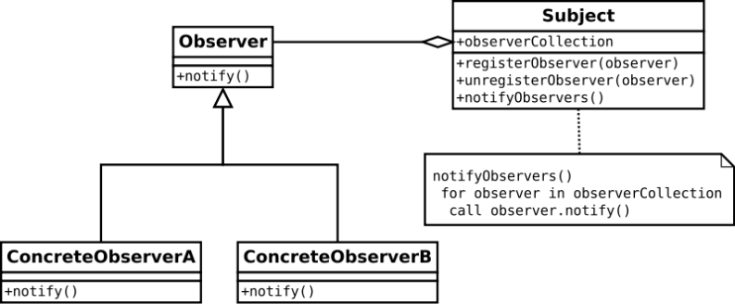
What is Rx?
LINQ to events
Sequences, potentially infinite
Functional (composition, map/reduce)
Lazy
Push based
Dramatically changes control flow
Publish/subscribe
Observer pattern
Notes:
LINQ – transforming sequences (map + fold), composing operators, building pipelines, lazy

Slide 4
The 5 stages of Rx Enlightenment
Mind blown
Baby steps
Magic hammer
Enlightenment
Hubris

Slide 5
The 5 stages of Rx Enlightenment
Mind blown
Baby steps
Magic hammer
Enlightenment
Hubris
}
Reading the code

Slide 6
It’s Just Code
Notes:
Rx is Open Source – codeplex
V2 more complex than V1, due to PCL

Slide 7
CODE!
Notes:
Not an intro to Rx – naïve implementations

Slide 8
What did we miss?
Concurrency/Asynchrony
Implementation
Single threaded by default
SubscribeOn/ObserveOn operators
Schedulers
Schedule an action to be run
Run immediately, at time, after interval
Platform specific
130 operators, 620 overloads
More Subjects
Testing – Materialize, virtual scheduler
Interop with async/await, TPL, events
Qbservable (IQueryabe for Rx)
Interactive Extensions (Ix)
Joins – patterns matching multiple inputs
Notes:
SubscribeOn pushes subscription processing onto the scheduler
ObserveOn pushes observation onto the scheduler
Scheduling – Replay, Buffer, generate, Timeout, Throttle, etc
Schedule simply schedules an ac
Joins based on Join calculus. Blows my head off. Developed to provide a formal basis for the design of distributed programming languages

Slide 9


It’s Just Code
@citizenmatt https://www.github.com/citizenmatt/ndc-london-2013
Notes:
Rx is Open Source – codeplex
V2 more complex than V1, due to PCL

